Slide 1
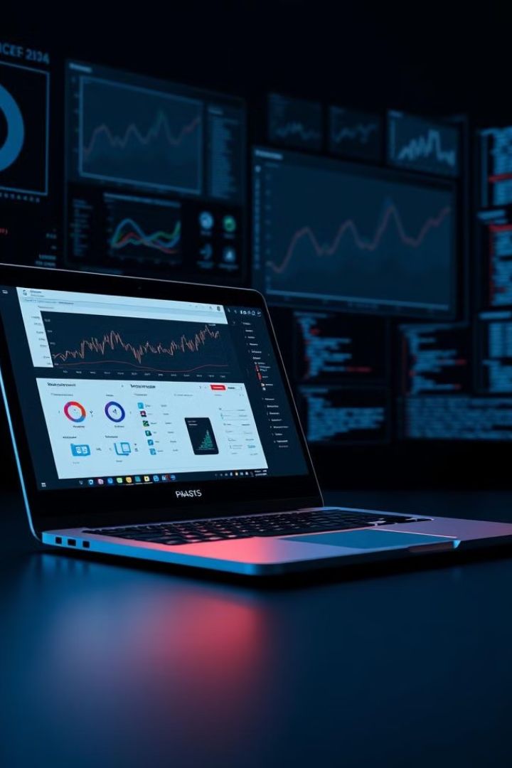
Laptop Price Prediction (PredLap)
Team : Mohamed Mohsen - Mohamed Emad - Mariam Abdalkader - Zeyad Elkholy - Sara Gamal
Track : Microsoft Data Engineer
Supervisor : Moshira

Slide 2

Laptop Price Prediction Project Overview
This project aims to build a system that can accurately predict laptop prices.
The objective is to create a Machine learning model capable of predicting prices based on laptop specifications, using web scraping and data warehousing techniques.
The project is motivated by the knowledge and awareness of laptops prices to build your decision.

Slide 3
Technologies Used To Build PredLap

Slide 4
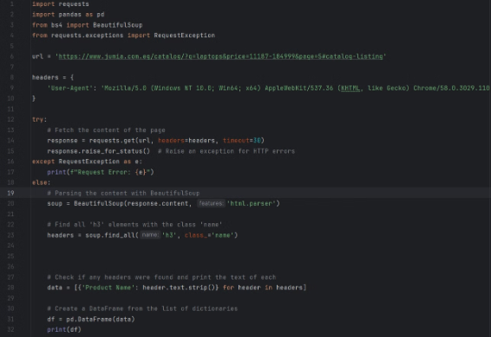
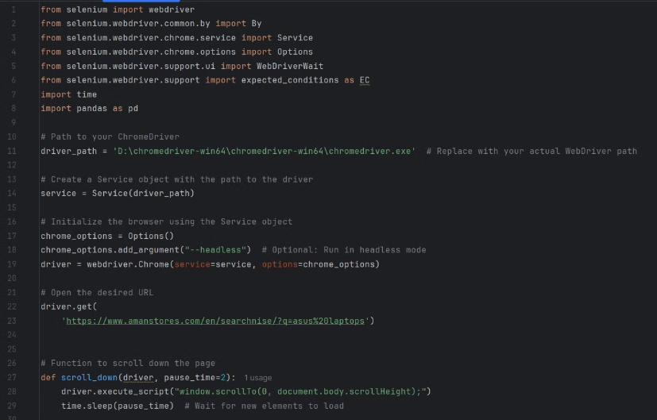
Web Scraping with BeautifulSoup & Selenium
BeautifulSoup
Selenium
BeautifulSoup is a Python library that helps parse HTML and XML data. It's powerful for extracting structured data from web pages, such as product information, prices, and specifications.
Selenium is a browser automation framework. It can simulate user actions on websites, enabling us to navigate through dynamic websites and extract data that is loaded dynamically.

Slide 5
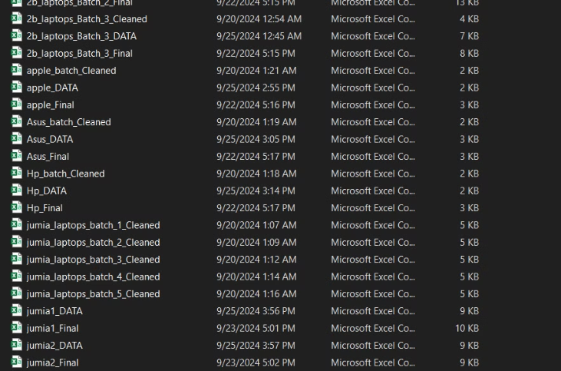
Data is saved as CSV
After Extracting Data from websites using Web Scraping and after applying some preprocessing , data is saved as Batches with CSV Format (12 File) to be loaded into a Database

Slide 6

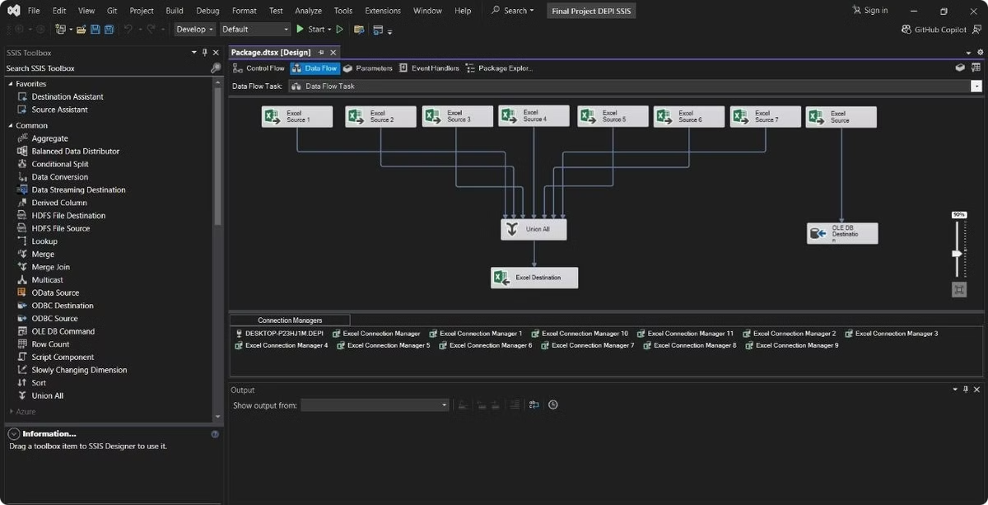
Data Warehousing with SSIS
1
Data Extraction
The scraped data from the web is extracted into a format suitable for analysis, such as CSV files.
2
Data Transformation
SSIS (SQL Server Integration Services) is used to transform the extracted data into a consistent structure, handling data cleansing, aggregation, and other data preparation tasks.
3
Data Loading
Finally, the transformed data is loaded into the data warehouse, where it is stored and organized for efficient querying and analysis.

Slide 7

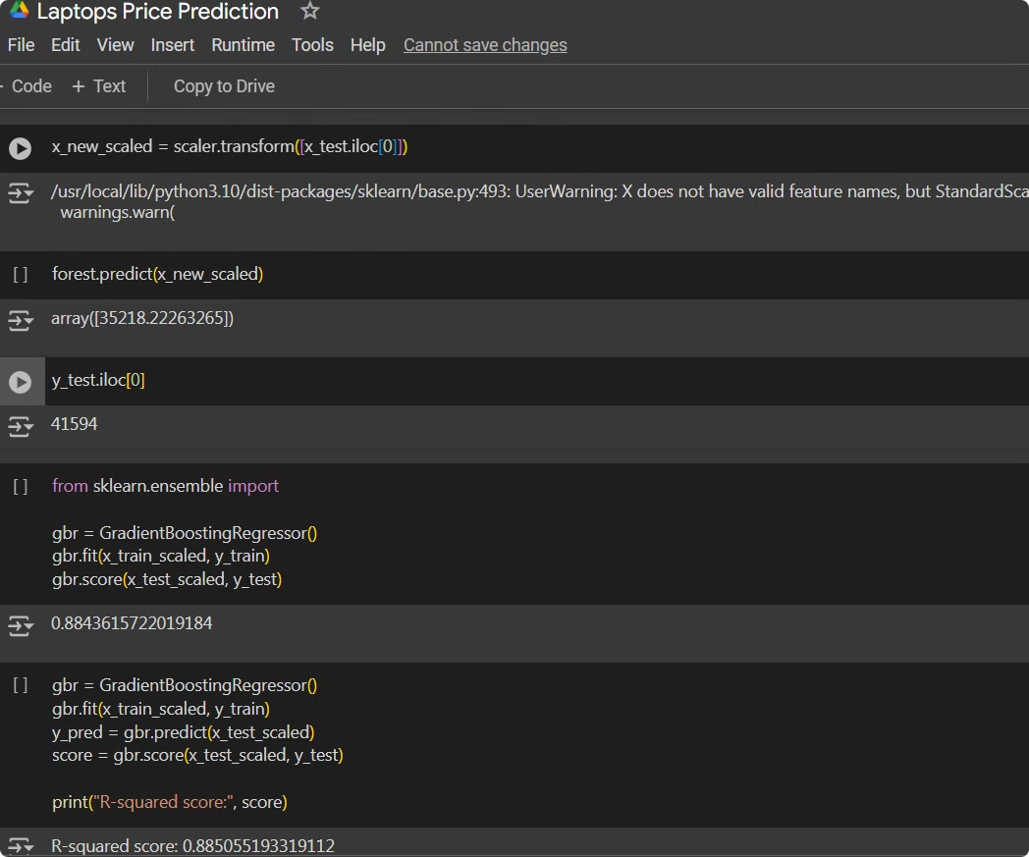
Machine Learning Model for Price Prediction
1
Feature Engineering
We engineered features from the data, selecting relevant variables such as brand and specifications to predict the price.
2
Model Selection
Several machine learning models were explored, such as linear regression, random forests, and gradient boosting , Eventually we chose Gradient Boosting
3
Model Training
The chosen model was trained on the prepared data to learn the relationships between features and laptop prices , We used 80% of the Data for training and 20% for Testing Accuracy.
4
Model Evaluation
We evaluated the model's performance using metrics such as accuracy, MSE, and R-Squared to ensure it accurately predicts laptop prices. We got 88% as Model Accuracy .

Slide 8
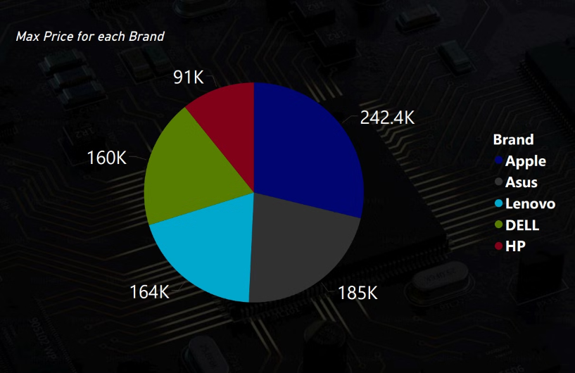
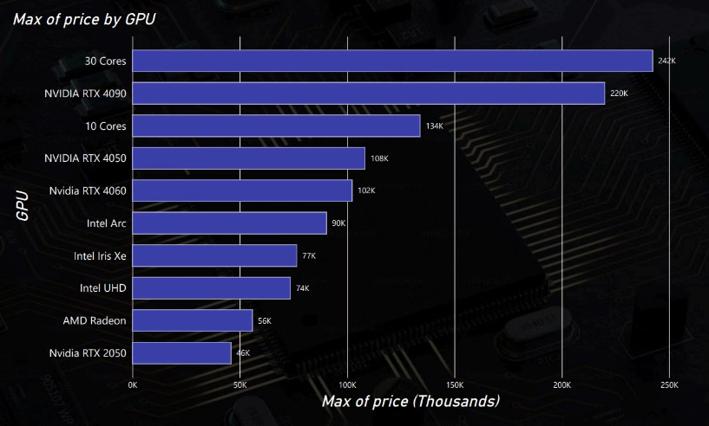
Power BI For Visualization
Max Price for each GPU
Max Price for each Brand
Explore the highest GPU prices in relation to laptop prices with this informative breakdown.
Discover the maximum laptop prices from leading brands showcased in this Visualization.

Slide 9


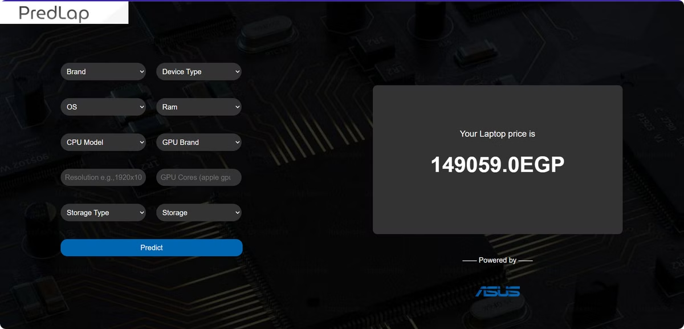


Flask App for User Interaction
Input Form
The app provides a user-friendly form where users can input details about the laptop, such as brand, model, specifications, and desired features.
Price Prediction
Upon submission, the app utilizes the trained machine learning model to predict the price of the laptop based on the provided specifications.
Results Display
The predicted price is displayed to the user, providing an estimate of the laptop's value in the market.

Slide 10


Benefits of this Project
Informed Purchasing Decisions
The app empowers users to make informed purchasing decisions by providing them with an estimated price range for laptops.
Market Understanding
By analyzing data from various online retailers, the project provides insights into the current market trends and pricing strategies from Websites like Noon , 2B , Vodafone , Aman and Jumia
Personalized Pricing
The model can be customized to incorporate specific market preferences, allowing for personalized price predictions.

Slide 11





Future Enhancements
Geographic Pricing
Time Series Analysis
User Feedback Integration
Mobile App Development
Incorporate location-based pricing variations, considering regional price differences and market demands.
Analyze historical price data to predict future trends and seasonality in laptop pricing.
Allow users to provide feedback on predicted prices, improving model accuracy and user experience.
Extend the functionality to a mobile app, providing on-the-go price predictions for users.

Slide 12
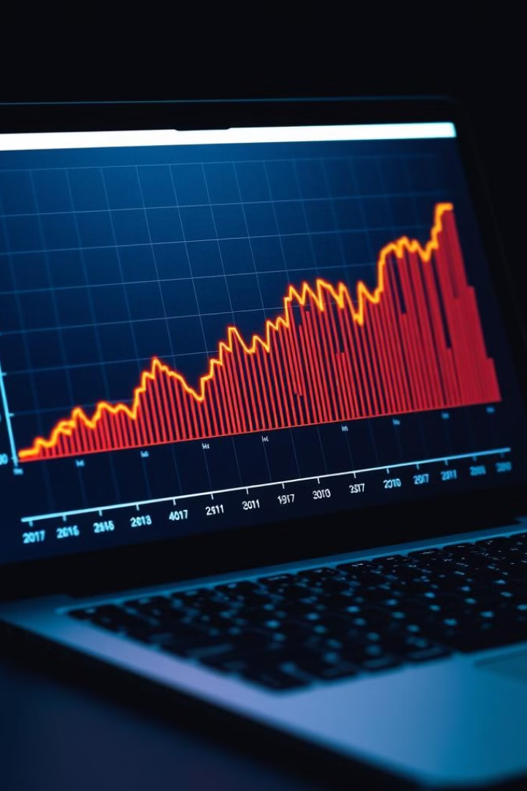
Conclusion
This project demonstrates a successful application of data science techniques for predicting laptop prices. By combining web scraping, data warehousing, and machine learning, we built a valuable tool for informed purchasing decisions. Future enhancements will further improve accuracy and expand the app's functionality.

Slide 13

Thank You
Thank you for your interest. We appreciate your feedback and hope this presentation was informative.

